Slide 1
Guide to Parallel Park Pure CSS animation

Slide 2
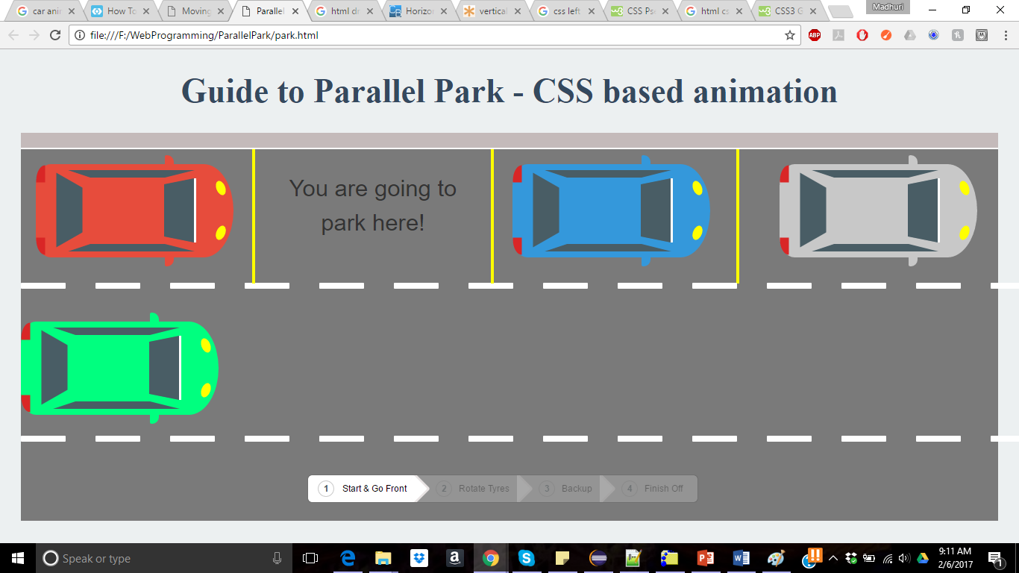
Screenshot of the homepage

Slide 3
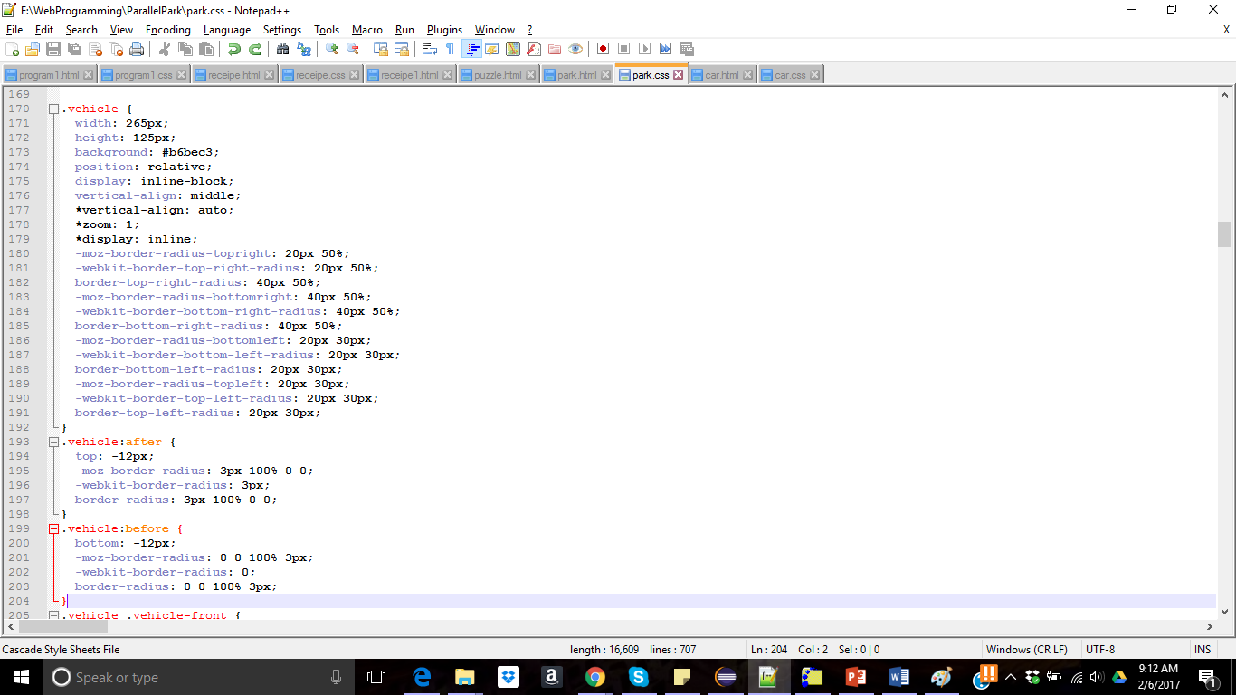
Car – CSS code

Slide 4
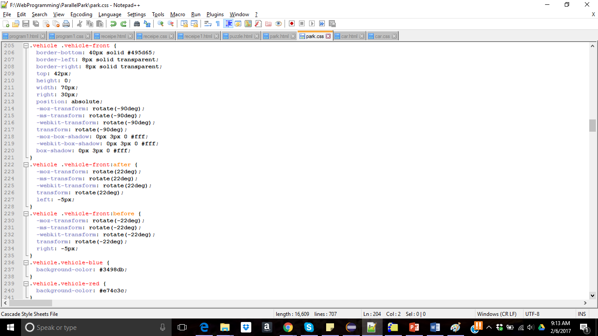
Car Front– CSS code

Slide 5
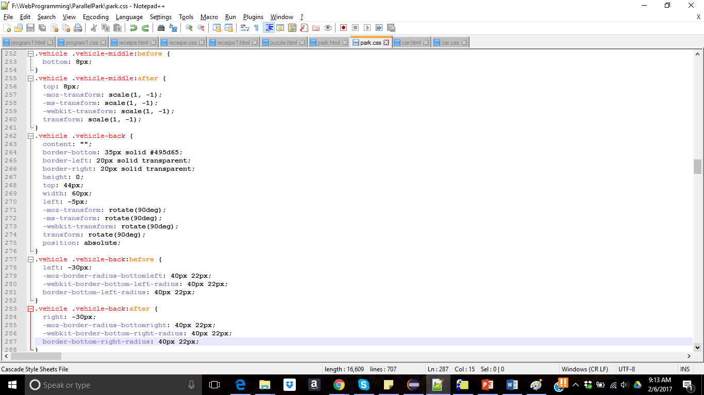
Car Middle and back– CSS code

Slide 6
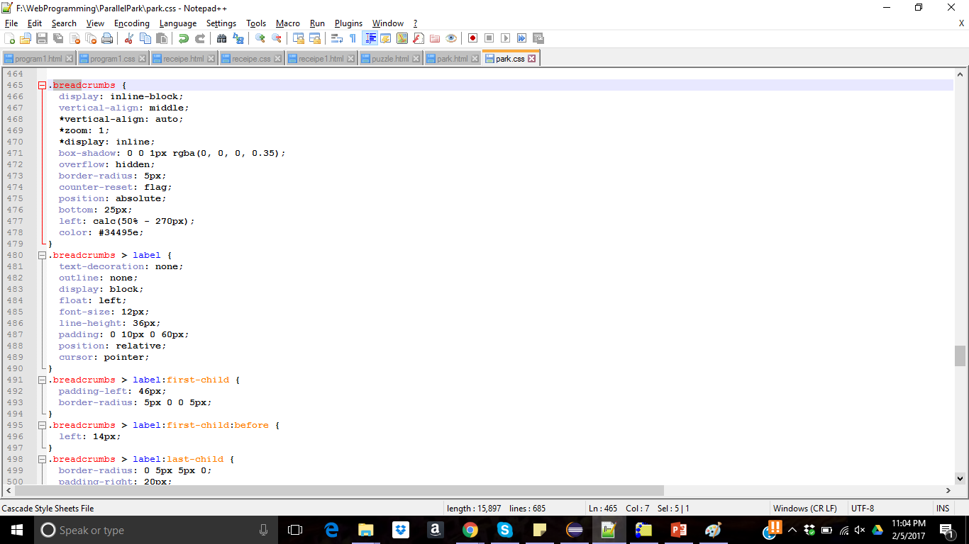
Breadcrumbs Effect

Slide 7
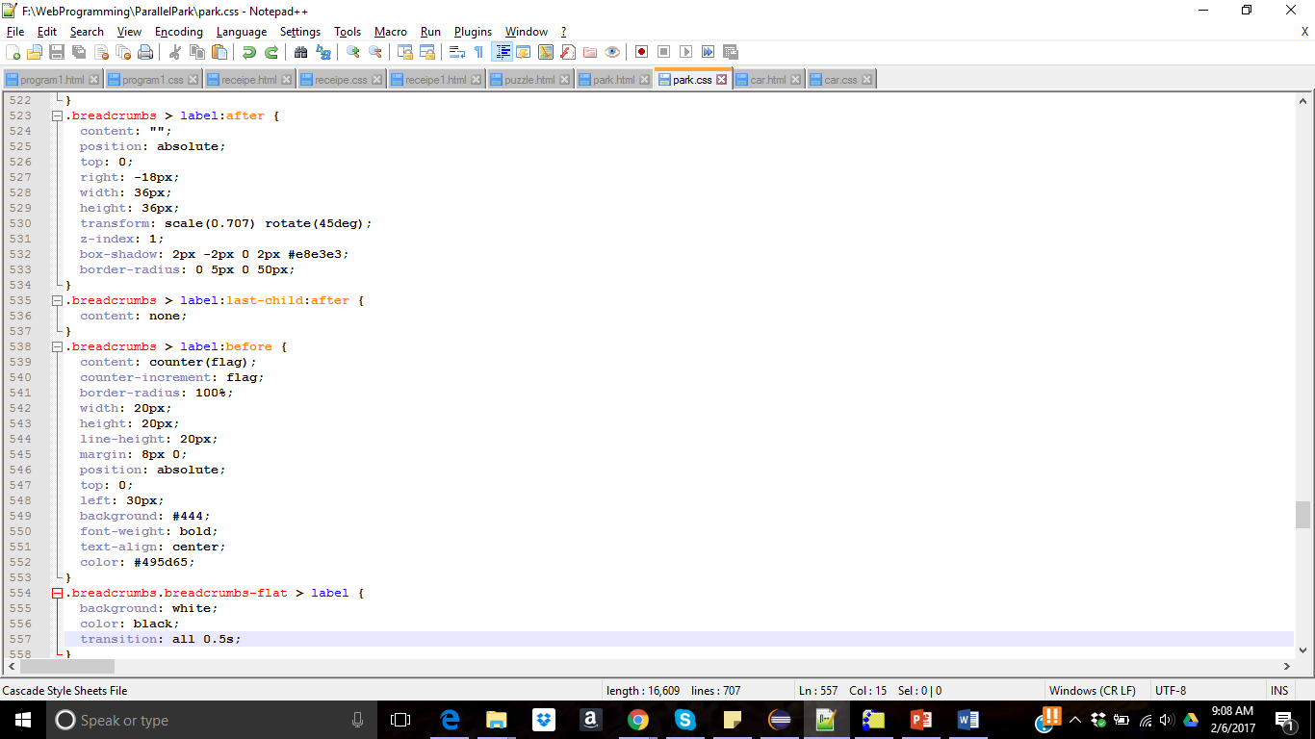
Breadcrumbs Effect

